Slide 1

rNext – Environments and Branching
March 2019
CLM
November 2018
For internal use only

Slide 2
Agenda
Purpose
Future State (Go live, r1.0.x, r1.x)
Why?
Next steps
Appendix

Slide 3
Purpose
The purpose of this deck is to outline the branching patterns and environment strategy for post go live development lifecycles currently known as “rNext” or “r1.1x and r1.0x”

Slide 4
Future State - Go live / hot fix (r1.0x) / r1.x
Multiple Environments:
DEV
JAD2 (DEV pro for now)
JAD3 (New - DEV)
TEST
SIT1 (FULL)
SIT2 (New – PARTIAL)
CERT
CRT1 (FULL)
PRD
Multiple Branches:
Production / GO live Branch = April 2019
“MASTER”
R.1.0.1 = HOT FIX & Must haves (post gold code launch)
“DEVELOP-1.0.x”
R1.x = ‘fast followers’, deferred defects, etc.
“DEVELOP-1.1.x”
Multiple Paths
R1.0.X
JAD2 ->SIT1->CRT1->PRD
R1.1.X
JAD3 -> SIT2->CRT1->PRD

Slide 5




Post go live - Branching with TFSGit
Development
SCM
Testing
SCM
Deploy
Deploy
Build
Pull request, code review and merge
R1.0X Feature N
R1.0X DEVELOP
SIT1
R1.0x DEVELOP
Production
JAD2
R1.0X Feature N
R1.0X Feature N
Regular
merges
from r1.0
Pull request, code review and merge
Devs create feature branches and commit their code to them
Deploy
from
master
CRT1
PRD
Pull request, code review and merge
MASTER
JAD3
R1.1.X Feature N
SIT2
R1.1.X Feature N
R1.1x DEVELOP
Pull request, code review and merge
R1.1.X Feature N
R1.1x DEVELOP
R1.0X Feature N
R1.X Feature N
R1.0X DEVELOP
R1.1x DEVELOP
MASTER
MASTER
Short lived Feature branches based of long living parent branches.
Long living develop branches e.g. r1.0.1 HOT FIX or r.1.1
Master branch

Slide 6
Why this strategy?
Keeps an existing runway / only building a new r.1.1x runway
Continuous Integration
Sets us up for Continuous Deployment in future – more efficient and accurate deployments using tools like Jenkins
Encourages code reviews early/earlier in the stage
Audit trail for who changed what
Supports multiple streams that can merge other’s changes

Slide 7

Next steps
Determine environment strategy
Determine Source control repo (TFS or GITlab?)
Sticking with tfsgit (for now)
Determine Branching Strategy
GITflow
Integration considerations for r1.1 path
G:\BUF018\CLM - Technology Development\Integration
These will not be integrated enviornments
Build SFDC/nCino environments (3-5 days)
Build branches (1 day)
Implement and Train on new process (2 days)
Getting Developers to start committing to commit to branches/training (ongoing)
ANT+GIT GUI? Eclipse? VS code?
Or simply let the Release Engineer continue to do it…for now

Slide 8

Appendix – gitflow branching strategy

Slide 9
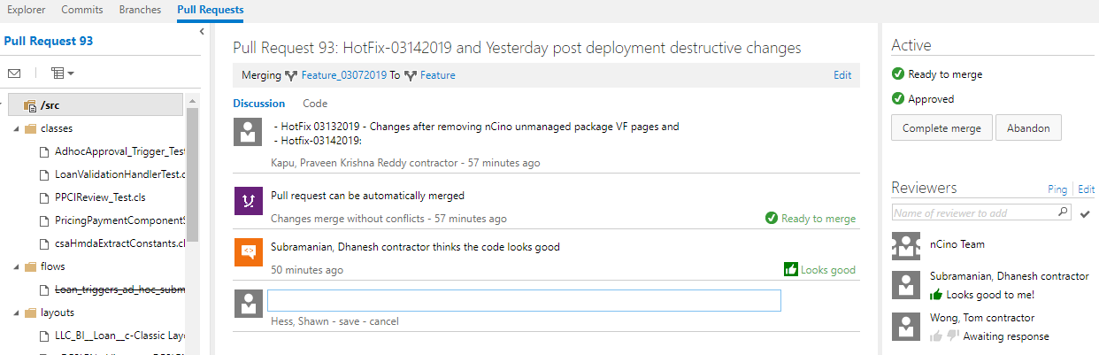
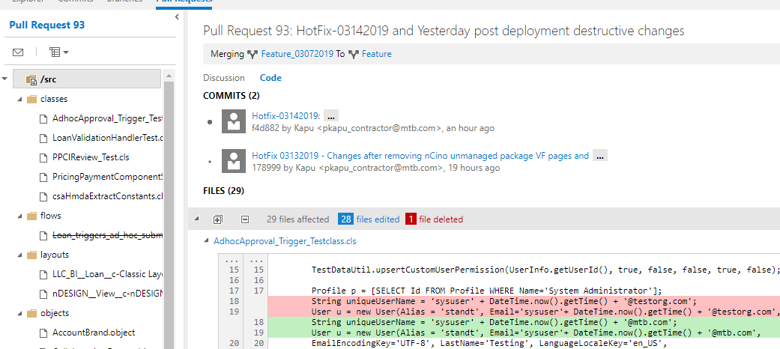
Appendix: example pull request

Slide 10









Appendix: Not too distant future state
Salesforce Cloud – Development Instance
Developer Local Machine With Eclipse / eGIT Tools
M&T DevOps Platform
Salesforce Sandboxes-UAT, Test & Prod
Save - Update Dev Instance
Git/TFS - Code Repository
PMD - Static Code Review & Commit
Code Review by Release Manager
Automated Deployment To Higher Org
1
2
3
4
Test
Salesforce Migration Tool
Code From Salesforce To Developer Machine
Pre-deploy Validation
Local Git/TFS Repository
5
6
7
8
UAT
Jenkins - Orchestration
Prod
M&T Tools
Developer Local Machine
Developer Machine -Eclipse IDE
GIT/TFS Repository
PMD – Code Review, Commit & Branching
Build Automation & Orchestration
Build Tool

